Slide 1
Illustrated BERT

Slide 2
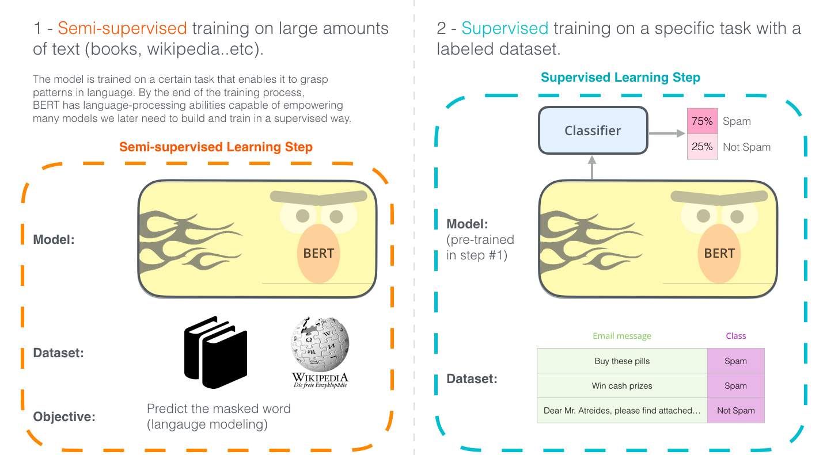

Slide 3
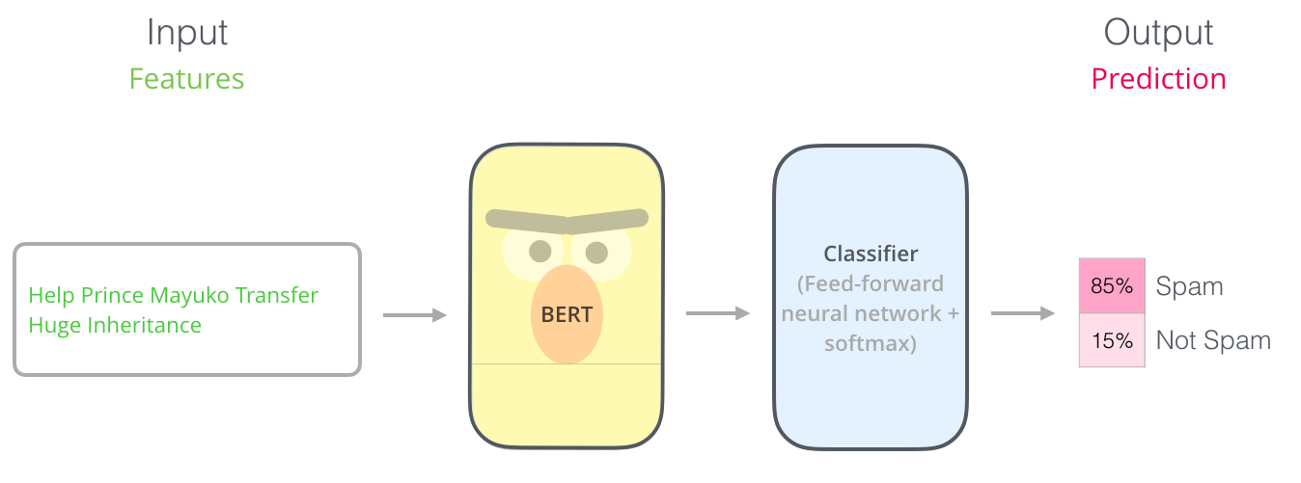
Sentence Classification

Slide 4
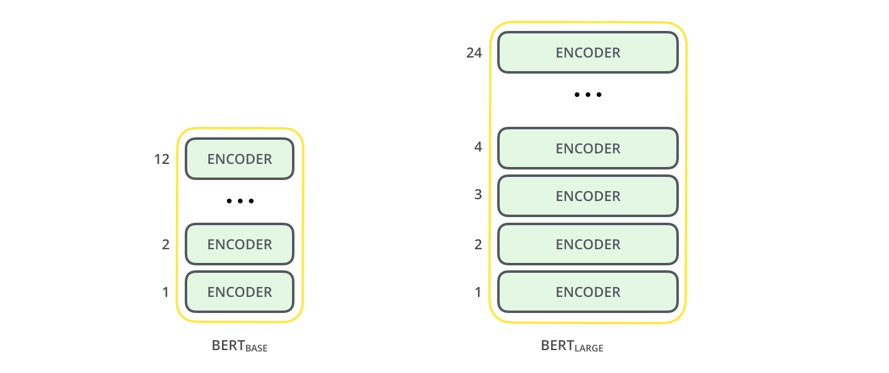
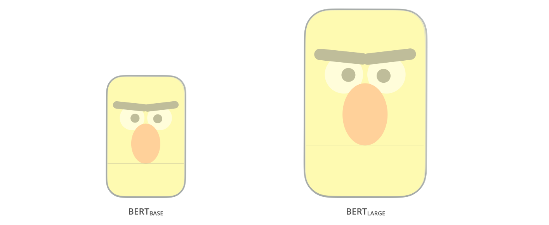
Architecture
Notes:
Both BERT model sizes have a large number of encoder layers (which the paper calls Transformer Blocks) – twelve for the Base version, and twenty four for the Large version. These also have larger feedforward-networks (768 and 1024 hidden units respectively), and more attention heads (12 and 16 respectively) than the default configuration in the reference implementation of the Transformer in the initial paper (6 encoder layers, 512 hidden units, and 8 attention heads).

Slide 5
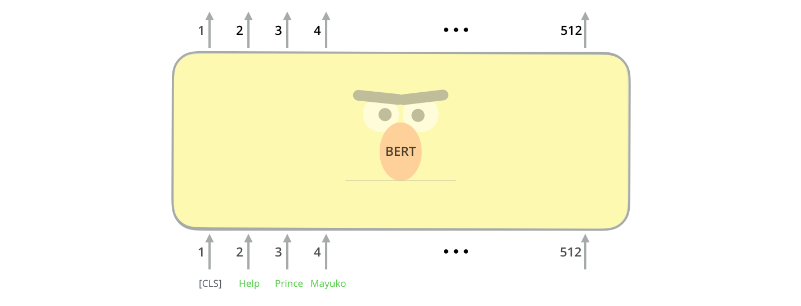
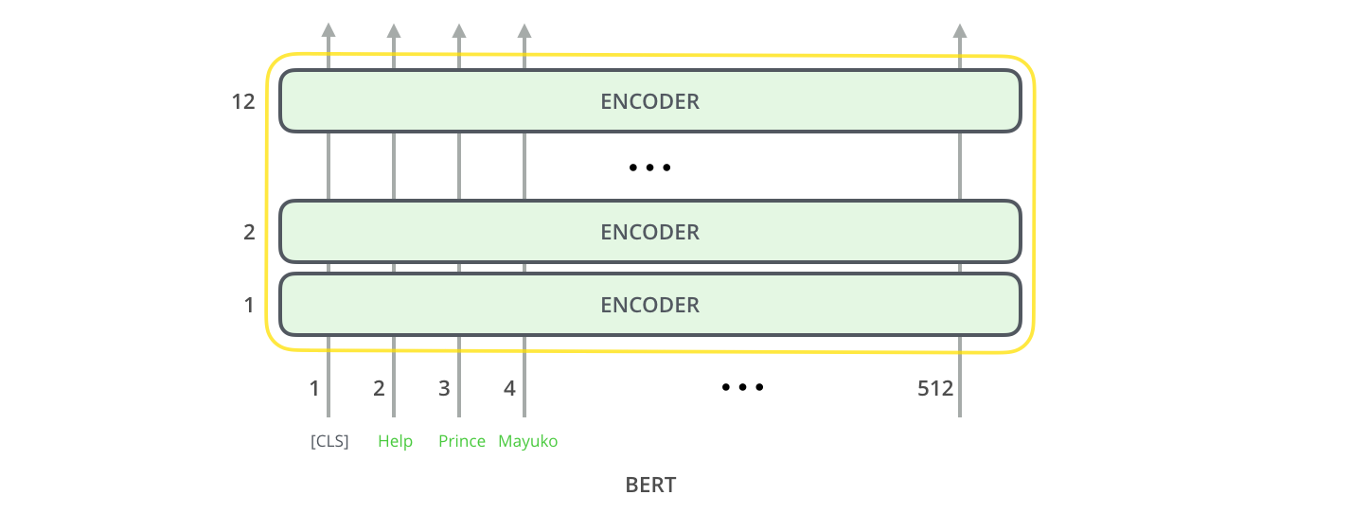
Model Input
Notes:
The first input token is supplied with a special [CLS] token for reasons that will become apparent later on. CLS here stands for Classification.
Just like the vanilla encoder of the transformer, BERT takes a sequence of words as input which keep flowing up the stack. Each layer applies self-attention, and passes its results through a feed-forward network, and then hands it off to the next encoder.

Slide 6
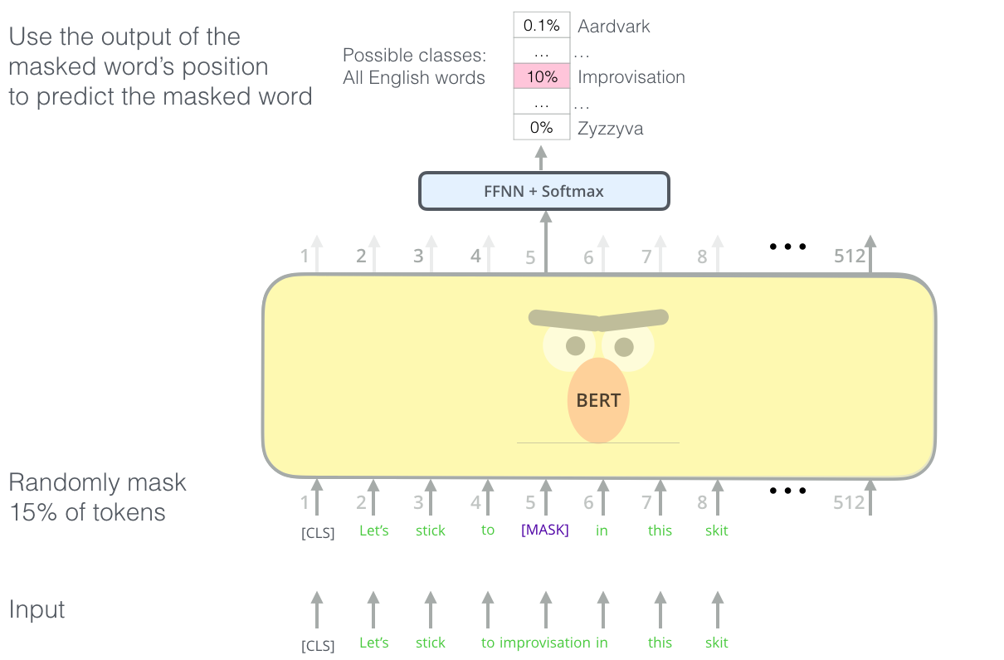

Slide 7
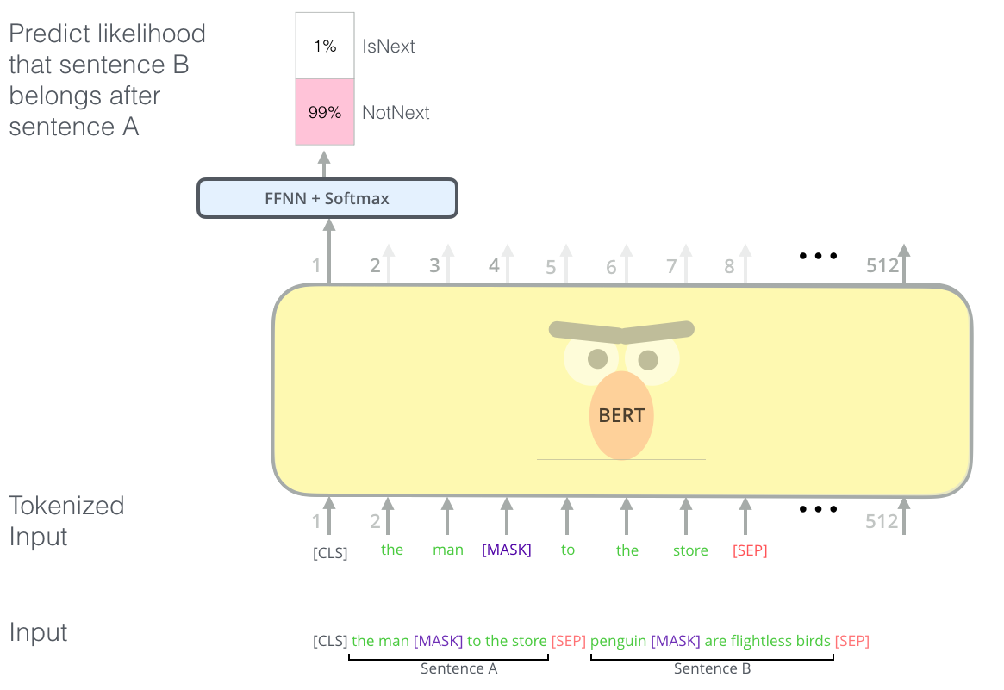

Slide 8
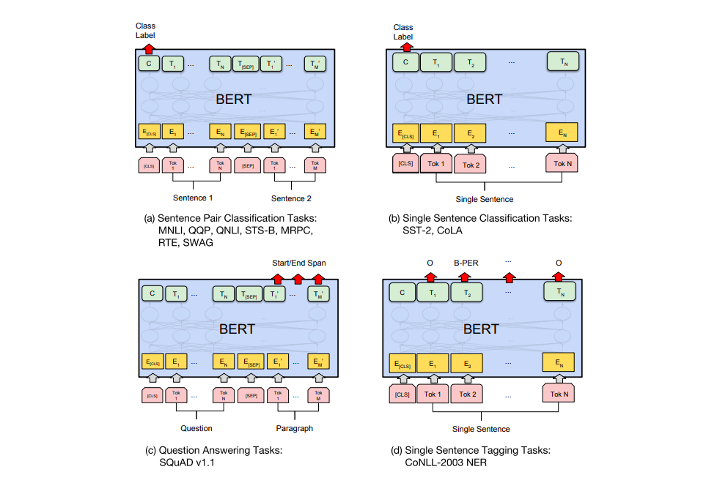

Slide 9
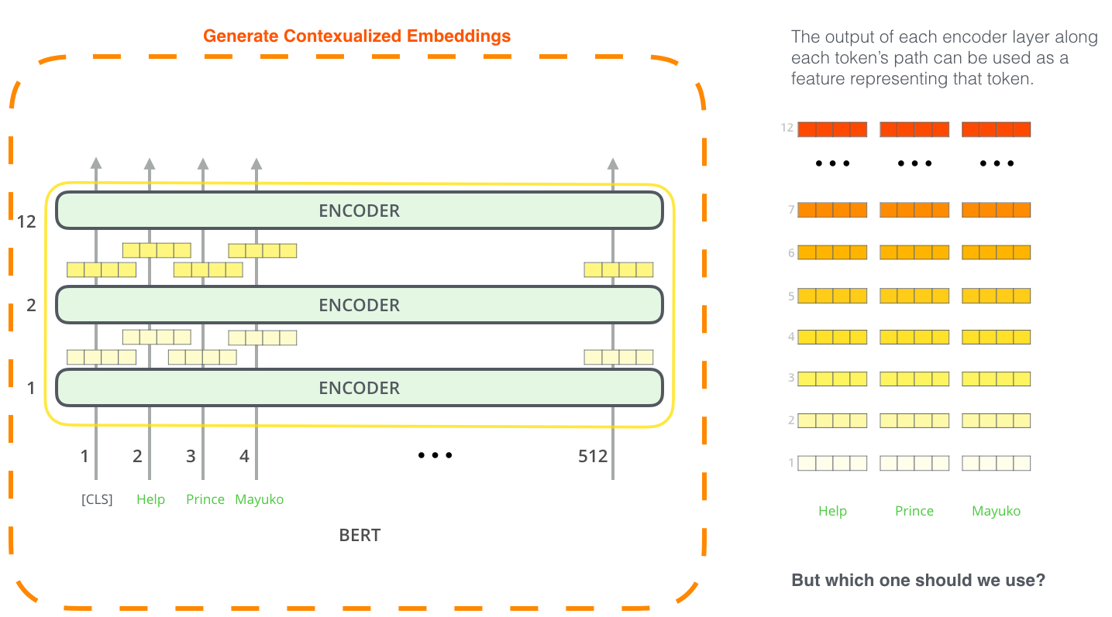
Feature Extraction

Slide 10
Using Bert Embeddings for Classification

Slide 11
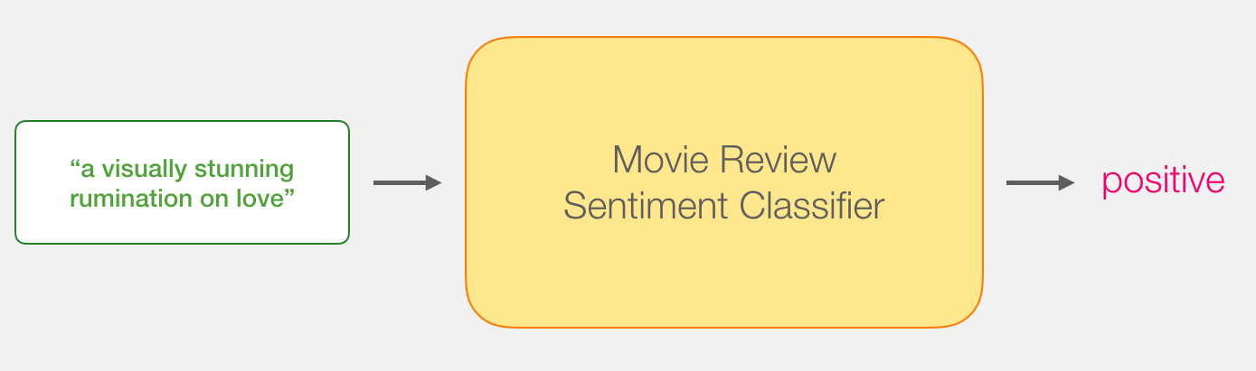
Sentence Sentiment Classification

Slide 12
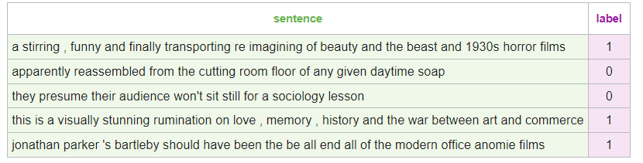
DataSet
The dataset we will use in this example is SST2, which contains sentences from movie reviews, each labeled as either positive (has the value 1) or negative (has the value 0):

Slide 13
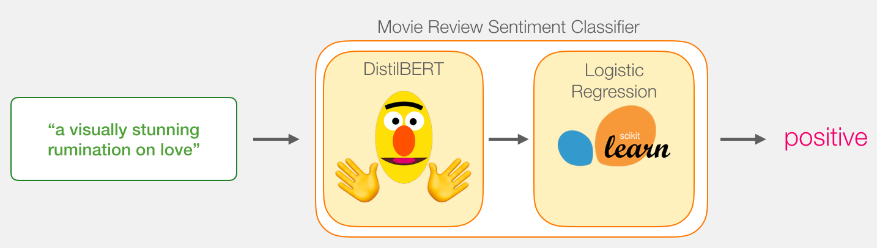
Model
Notes:
Under the hood, the model is actually made up of two model.
DistilBERT processes the sentence and passes along some information it extracted from it on to the next model. DistilBERT is a smaller version of BERT developed and open sourced by the team at HuggingFace. It’s a lighter and faster version of BERT that roughly matches its performance.
The next model, a basic Logistic Regression model from scikit learn will take in the result of DistilBERT’s processing, and classify the sentence as either positive or negative (1 or 0, respectively).
The data we pass between the two models is a vector of size 768. We can think of this of vector as an embedding for the sentence that we can use for classification.

Slide 14
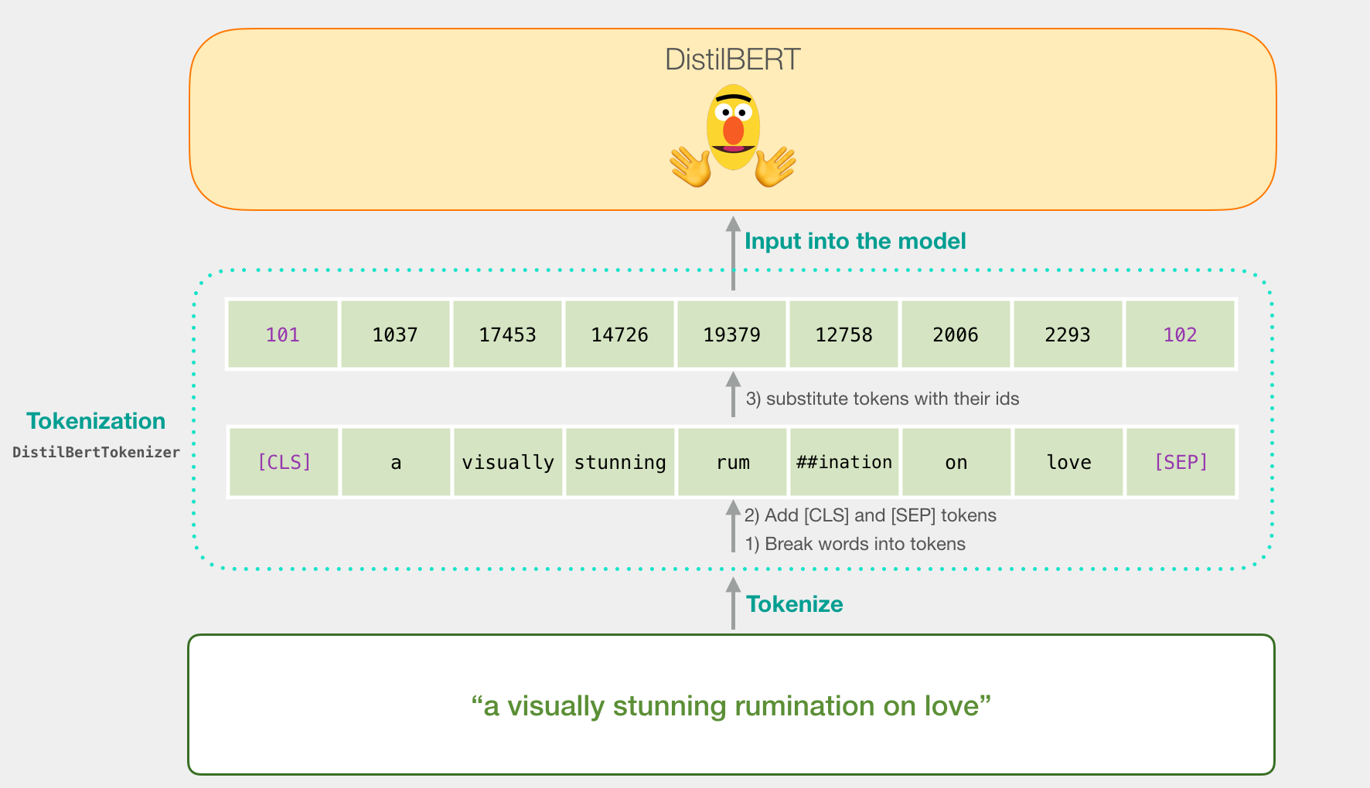
Tokenization

Slide 15
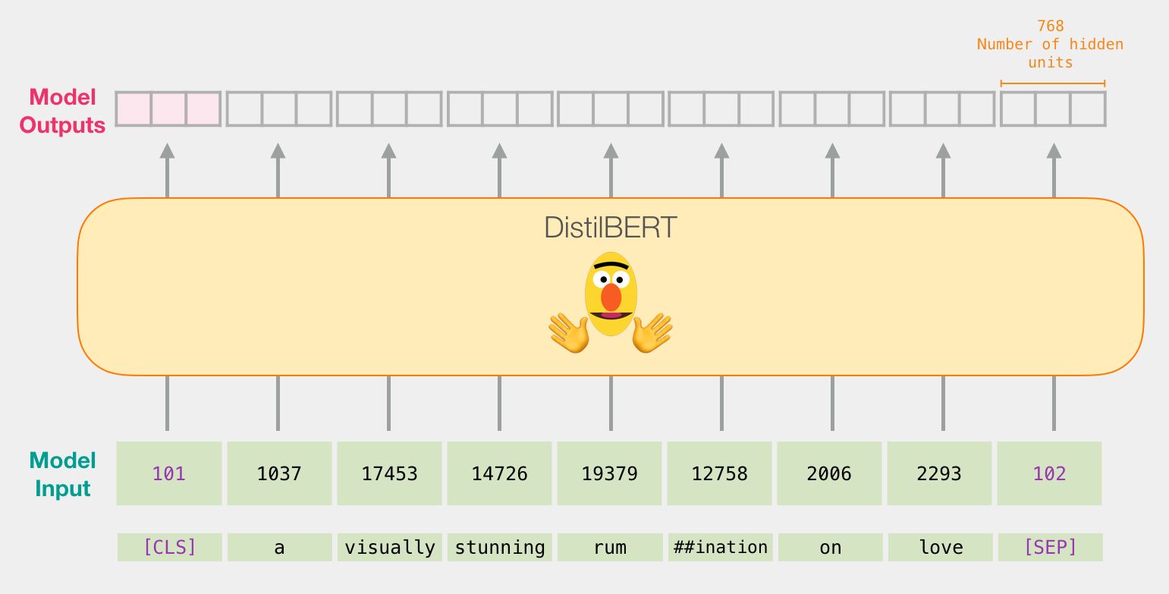
Sentence embedding

Slide 16
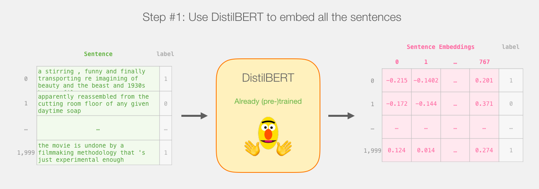
Generating data

Slide 17
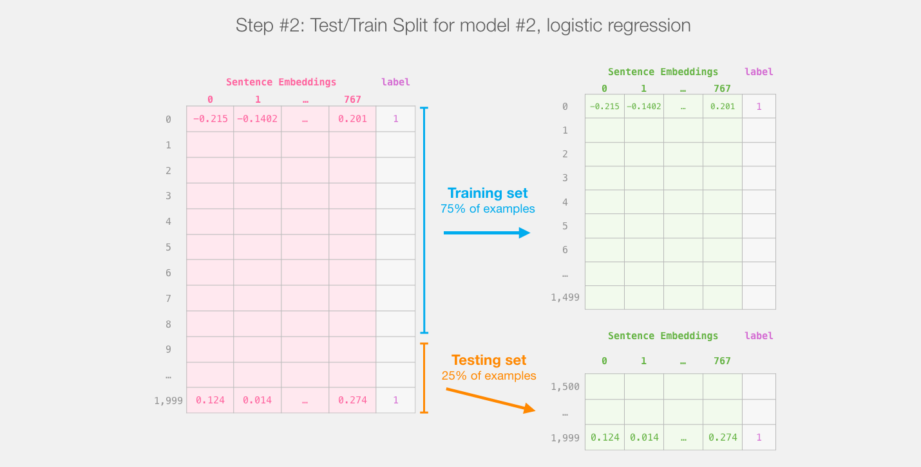
Train-test Split

Slide 18
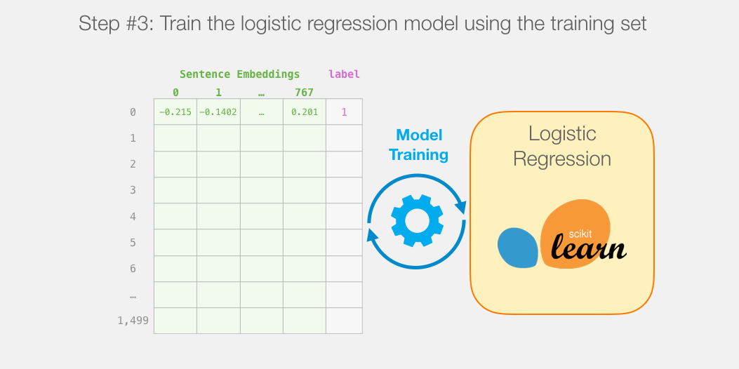
Training Logistic regression

Slide 19
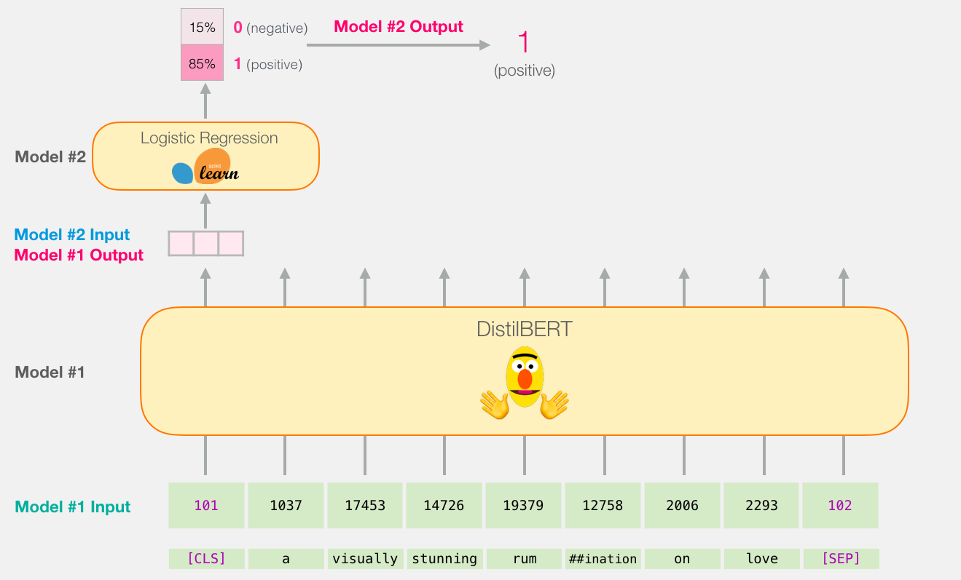

Slide 20
references
https://jalammar.github.io/illustrated-bert/
https://jalammar.github.io/a-visual-guide-to-using-bert-for-the-first-time/

